Slide 1
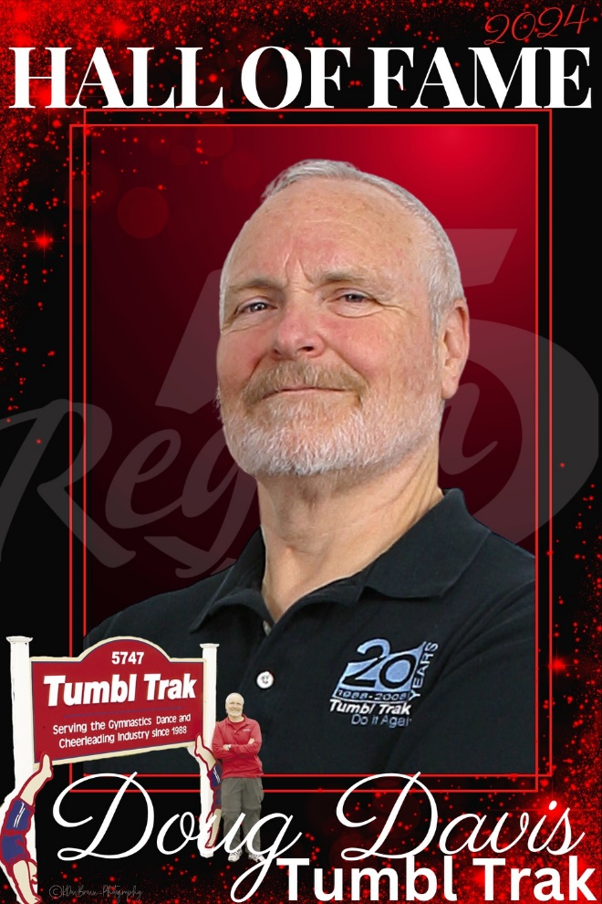
Doug Davis
Founder of Tumbl Trak
HALL
OF
FAME
Inducted 2024

Slide 2
Doug Davis
Class of 2024
Doug Davis has been a part of Region 5 for over 35 years as a competitor and coach in Michigan and Wisconsin. As the President and Founder of Tumbl Trak, Doug has been a tremendous asset to the advancement of the sport of gymnastics. He has been an instrumental part in creating training environments that would reduce spotting for coaches, increase the number of repetitions an athlete could perform as well as help them prevent overuse injuries. His tireless efforts have lead to innovative designs that have improved, not only the skills, but the health of gymnasts worldwide. Doug’s commitment to safer training products, education and overall fitness is a tribute to his knowledge and respect for the sport, the coaches and most of all the athletes.

